Slide 1



18CEP108L – MAIN PROJECT
INFLUENCE OF ALUMINIUM POWDER IN MECHANICAL PROPERTIES OF CEMENT MORTAR
PRESENTED BY KANISHKKA R (20BCE4013) |  | GUIDED BY Dr.V.SENTHIL KMAR,
NAVEEN P | (20BCE4020) | Head of the Department,
KESAVAN K | (20BCE4305) | Department of Civil Engineering,
 |  | M.Kumarasamy College of Engineering,
 |  | Thalavapalayam, Karur(TN)-639113.

Slide 2
NEED FOR STUDY
The study addresses a need in the environmental impact of traditional construction materials and construction for lightweight, sustainable materials and contributing into the potential of aluminium powder repurposing for enhancing mortar properties.

Slide 3
OBJECTIVES
The objective of this study is to analyse the strength performance of cement mortar containing aluminium powder. The significance of the use of aluminium powder in mortar is to reduce the weight of the building and to address the environment issues and enhanced fire resistance.

Slide 4
METHODOLOGY
TOPIC SELECTION
LITERATURE REVIEW
CEMENT
M-SAND
MATERIAL COLLECTION
ALIMINIUM POWDER
FLY ASH
MATERIAL TESTING
LIME
ARRIVING TRIAL MIXES
GYPSUM
CASTING OF SPECIMENS
TESTING OF SPECIMENS
COMPRESSIVE STRENGTH
WATER ABSORPTION
ACID PENETRATION
RESULTS AND DISCUSSION

Slide 5
SCOPE FOR STUDY
The scope for the study is to identify the optimum mix with varying aluminium powder content to produce lightweight mortar by achieving highest compressive strength to be used in construction.

Slide 6
LITERATURE REVIEW
SN | SOURCE | RESULT
1 | Ramesh Kumar Paikara a, Tek Raj Gyawali(2023) Influence of aluminum powder content and powder-to-sand ratio on the physical and mechanical properties of aerated lightweight mortar | The 28-day densities of M3 were 961 kg/m³and 944 kg/m³, both below 1000 kg/m³, with only 0.6 % and 0.9 % aluminium powder contents, respectively and compressive strengths are 7.63MPa and 6.80MPa
2 | Ayad S. Aadi, Taghreed Khaleefa Mohammed Ali,Rafal Ahmed Abbas Ali ,Mohammed Mosleh Salman(2021). The mechanical properties of green mortar contained aluminum wastes as substitution of sand | The usage 5% of AW in cement mortar for structural application, and equal or greater than 15% of AW to produce. Lightweight cement mortar for non– structural application
3 | E. Muthu Kumar, K. Ramamurthy(2015) Effect of fineness and dosage of aluminium powder on the properties of moist-cured aerated concrete | For a constant dosage of Al powder and water–cement/solids ratio of the mix, the dry density achieved reduces appreciably with an increase in fineness of Al powder.
4 | Rana Shabbar, Paul Nedwell, and Zhangjian Wu(2018) Porosity and Water Absorption of Aerated Concrete with Varying Aluminium Powder Content | The water absorption of AC increased with decreasing the density for all the ages and the values were higher for the earlier age.

Slide 7
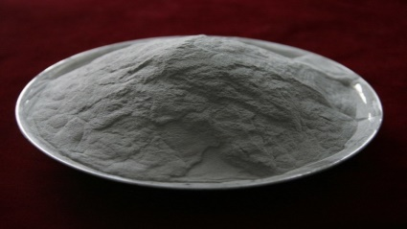
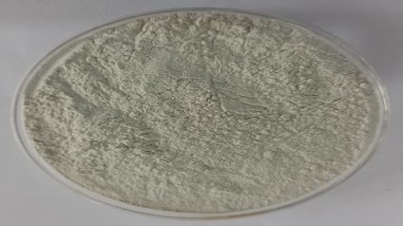
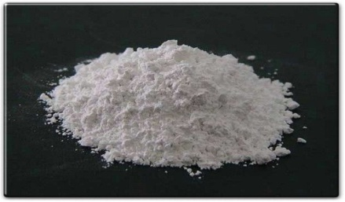
MATERIALS USED
ALUMINIUM POWDER
specific gravity - 2.7
density - 2700kg/m³
size - 40 to 100μm
GYPSUM
specific gravity - 2.32
density - 1200kg/m³
LIME
specific gravity - 3.3
density - 640kg/m³

Slide 8
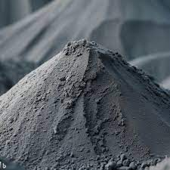
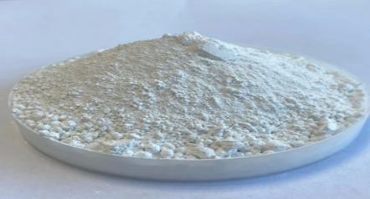
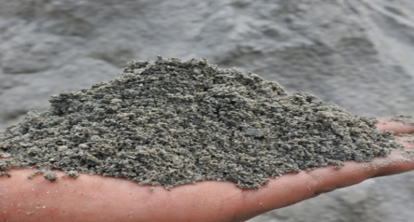
MATERIALS USED
CEMENT
specific gravity - 3.15
density - 1440kg/m³
FLYASH
specific gravity - 3.0
density - 860kg/m³
M-SAND
specific gravity - 2.439
density - 1850kg/m³

Slide 9
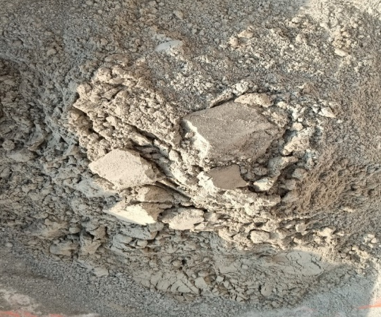
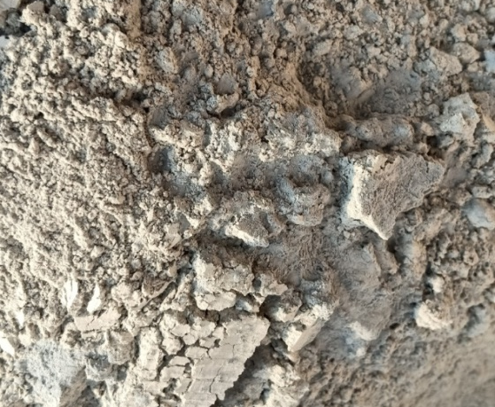
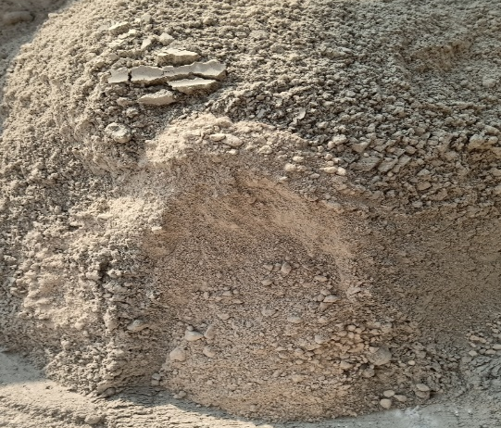
MIX PROPORTION
SN | MIX ID | CEMENT (gm) | FLY ASH (gm) | M-SAND (gm) | LIME(gm) | GYPSUM (gm) | AL POWDER (gm) | WATER (ml)
1 | AP0 | 230 | 0 | 690 | 0 | 0 | 0 | 115
2 | AP1 | 230 | 190 | 380 | 110 | 10 | 1.4 | 115

Slide 10
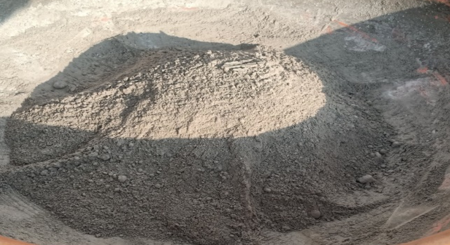
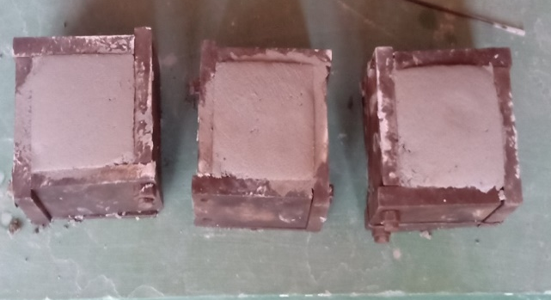
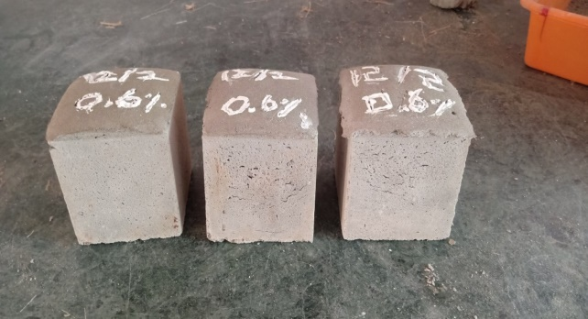
PREPARATION OF CEMENT MORTAR
The test specimens were casted in control mix proportions of 1:3 grade.
CASTING
The cube mould was placed in position on an even surface. All the interior faces and sides were coated with mud oil to prevent the sticking of mortar to the mould. mortar was poured into the mould using trowels. Hand compaction was done. The mortar was compacted in three layers.
COMPACTION
Hand operated compaction was done for all the cubes used in the test. The damping mild steel rods having point ends were used to poke the cement mortar and to make compaction complete

Slide 11
EXPERIMENTAL INVESTIGATION
COMPRESSIVE STRENGTH
Standard cubes 70.6mm x 70.6mm x 70.6mm are casted as per IS 4031 (part 6)-2000. Cement and sand ratio is used in the ratio of 1:3. Six cubes were casted for control mix for 7 and 28 days strength and another six cubes were casted with 0.6 % aluminium powder for 7 and 28 days strength. The water compressive strength of the specimen is calculated using the formula
Compressive strength = Load (N)
Area(𝑚𝑚²)

Slide 12
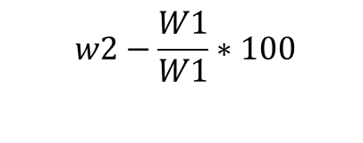
WATER ABSORPTION
The water absorption test was carried out in order to determine the increase in resistance towards water penetration in cement mortar. The standard cube molds of 70.6mm x 70.6mm x 70.6mm size were casted at the age of 28 days. Totally 6 cubes were casted and tested for water absorption. The test was done as per procedure given in ASTM C 642-97. After curing for 28 days, the specimens were dried in an oven at a temperature of 105⸰C for 48 hours and allowed to cool at room temperature. Thus the water absorption on the specimen is calculated using the formula
Water absorption % =
$$w2−\frac{W1}{W1}∗100$$

Slide 13
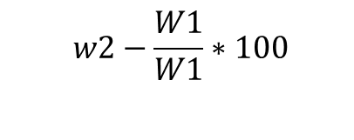
ACID PENETRATION TEST
The mixing and preparation procedures for acid penetration test were made in accordance with IS:4031 (Part 6) – 2000. Totally three cubes for control mix and three cubes for 0.6% aluminium powder were casted and tested for the test. By following the test procedure, acid attack experiment was carried out to analyse weight loss. At the age of 28 days, the specimens were dried in oven at 105⸰C and the initial weights were measured as W₁. Then the specimens were kept in the solution of water and hydrochloric acid for 28 days. The specimens were dried in oven at 105⸰C. Then the loss in weight of the specimen were measured as W₂. Thus the acid attack on the specimen is calculated using the formula
Acid attack % =
$$w2−\frac{W1}{W1}∗100$$

Slide 14
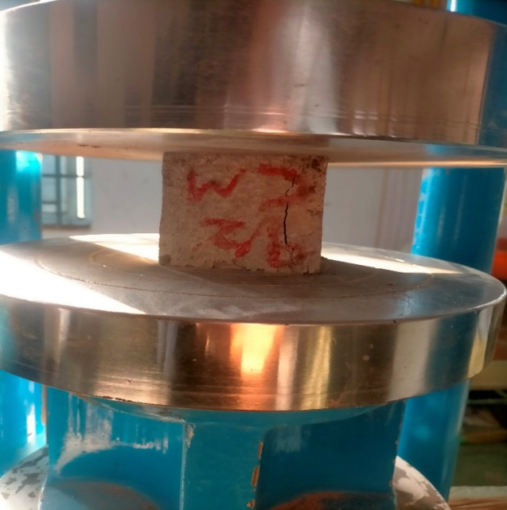
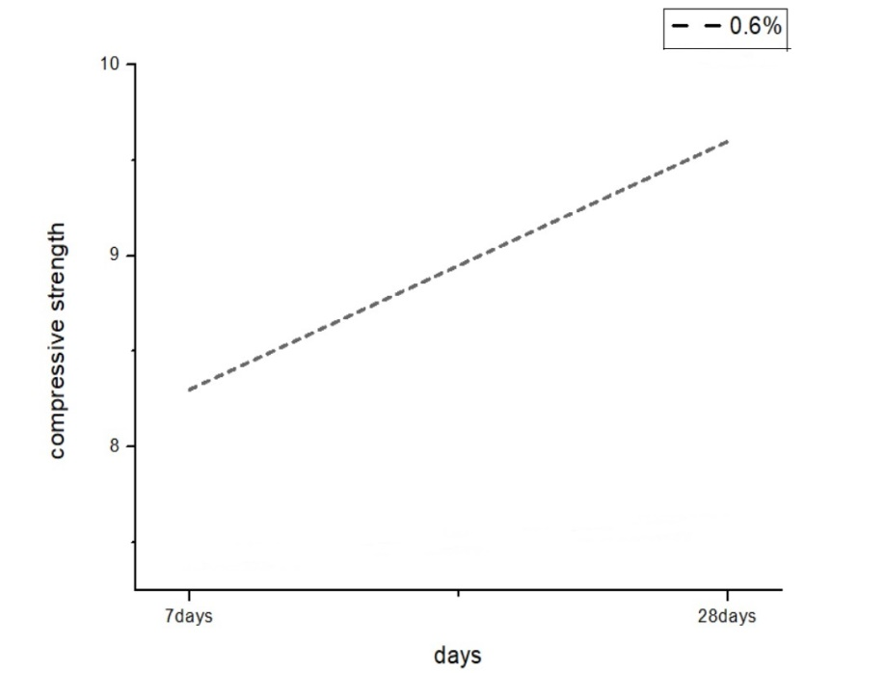
RESULT
COMPRESSIVE STRENGTH TEST
S.NO | NO.OF CURING DAYS | COMPRESSIVE STRENGTH
1 | 7 | 8.35 N/mm²
2 | 28 | 9.39 N/mm²

Slide 15
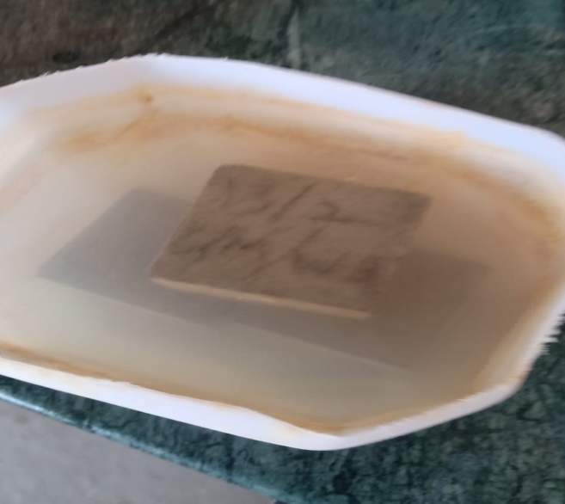
WATER ABSORPTION
MIX | AVG WATER ABSORPTION
CONTROL MIX | 7.03%
ALUMINIUM POWDER | 14.1%

Slide 16
CONCLUSION
The effectiveness of aluminium powder was most pronounced with higher powder to sand ratio.
The 7 and 28 day densities with 0.6% aluminium powder was 19.8% and 17.8% lesser than the control mix respectively.
The 7 and 28 day compressive strength with addition of 0.6% aluminium powder was 8.35 and 9.39 N/mm^{𝟐}.
The average water absorption for control mix and aluminium powder was 7.03% and 14.1% at the age of 28 days.

Slide 17
REFERENCES
Hameed, A., Mangi, S. A., Hakro, M. R., Kumar, A., Husnain, S. M., & Khan, A. (2023). Effect of Aluminium Waste Powder on the Strength Properties of Cement Mortar. Neutron, 23(01), 1-5.
Paikara, R. K., & Gyawali, T. R. (2023). Influence of aluminum powder content and powder-to-sand ratio on the physical and mechanical properties of aerated lightweight mortar. Cleaner Materials, 10, 100213.
Shabbar, R., Nedwell, P., & Wu, Z. (2018). Porosity and Water Absorption of Aerated Concrete with Varying Aluminium Powder Content. Int. J. Eng. Technol, 10(3), 234-238.
Shyam Sundar M, Sai Abhinav K, Dr J.Guru Jawahar.,& A.Anil(2021). An experimental study on fly ash based concrete with aluminium as partial replacement of cement. International Journal for Scientific Research & Development (IJSRD).
Vijayalakshmi, R., & Rajeswari, R. (2018). Characteristic study on behaviour of lightweight concrete using aluminium dross and aluminium powder. International Research Journal of Engineering and Technology (IRJET), 5(1).
Tebbal, N., & Rahmouni, Z. E. A. (2019). Valorization of aluminum waste on the Mechanical Performance of mortar subjected to cycles of freeze-thaw. Procedia Computer Science, 158, 1114-1121.
Noori, A. N., Aliewi, J. M., Salman, H. K., & Numan, H. A. (2021). Investigation of lightweight structural materials produced using aluminum scraps with cement mortar. Journal of Applied Engineering Science, 19(1), 252-257.
Aadi, A. S., Ali, T. K. M., Ali, R. A. A., & Salman, M. M. (2021). The mechanical properties of green mortar contained aluminum wastes as substitution of sand. Materials Today: Proceedings, 42, 3002-3009.

Slide 18
Parmar, A., Joshi, C., Head, A. P., Patel, U., Vaghasiya, A., Parmar, A., & Joshi, A. (2015). Light weight concrete using EPS beads and aluminium powder. In Proceeding of 3rd Afro-Asian international conference on science, engineering and technology (pp. 785-788).
Shabbar, R., Nedwell, P., & Wu, Z. (2017). Mechanical properties of lightweight aerated concrete with different aluminium powder content. In MATEC Web of Conferences (Vol. 120, p. 02010). EDP Sciences.
Gruszczyński, M., & Lenart, M. (2020). Durability of mortars modified with the addition of amorphous aluminum silicate and silica fume. Theoretical and Applied Fracture Mechanics, 107, 102526.
Kumar, E. M., & Ramamurthy, K. (2015). Effect of fineness and dosage of aluminium powder on the properties of moist-cured aerated concrete. Construction and Building Materials, 95, 486-496.
Chetry, P., & Goyal, E. R. Influence of Marble and Aluminium Waste Powder on the Performance of Concrete.
Reddy, K. C., & Kumar, S. D. Effect of Fly ash and Aluminum Powder on Concrete.
Hemanth, J. (2006). Compressive strength and microstructural properties of lightweight high-strength cement mortar reinforced with eloxal. Materials & design, 27(8), 657-664.
Suryavanshi, A. K., & Swamy, R. N. (2002). Development of lightweight mixes using ceramic microspheres as fillers. Cement and Concrete Research, 32(11), 1783-1789.
Hamad, A. J. (2014). Materials, production, properties and application of aerated lightweight concrete. International journal of materials science and engineering, 2(2), 152-157.
Gunasekaran, M. M., Saranya, G., Elamaran, L., Sakthivel, P., & Suresh, P. (2016). Development of light weight concrete by using autoclaved aerated concrete. International Journal for Innovative Research in Science & Technology, 2(11), 518-522.

Slide 19


